Slide 1

Bangladesh Army University of Engineering & Technology (BAUET)
Department of Computer Science and Engineering
Thesis on
Outlier detection in data mining Course Code : CSE-4100 & 4200
Course Title : Thesis
Presented By
Name: MD. Touhid Iqbal Sagar
ID: 18204023
Batch: 8th
Department: CSE
Supervised by
Md. Muktar Hossain
Lecturer, Dept. of CSE,
BAUET

Slide 2
Outline
Introduction
Objectives
Literature review
Experimental analysis of literature review
Motivation
Result analysis
Future Work
Conclusion
References

Slide 3
Introduction
Knowledge Discovery in Databases (KDD) Process:
Data Cleaning (Remove noise)
Data Integration (Combination of data)
Data selection (identify relevant data)
Data Transformation (transform into appropriate form)
Data Mining (Extract data pattern)
Pattern Evaluation (identify interesting pattern)
Knowledge Presentation (Present mined knowledge to the user)
Fig 02: KDD process

Slide 4
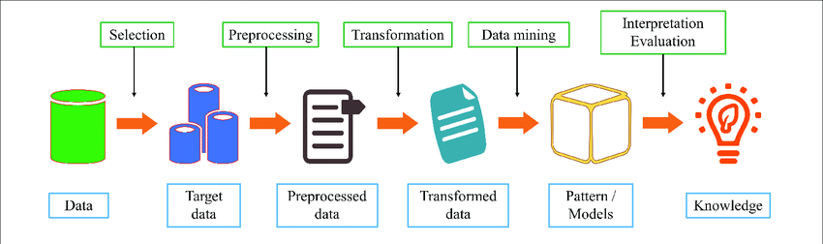
Introduction (Con’t)
Data Mining: Data mining is a process used to extract usable data from a larger set of any raw data.
Steps of Data mining:
Data Selection (Select required data)
Data Preprocessing (Process data)
Data Transformation (transform into appropriate form)
Data Mining (Extract data pattern)
Pattern Evaluation (identify interesting pattern)
Fig 01: Data mining steps

Slide 5
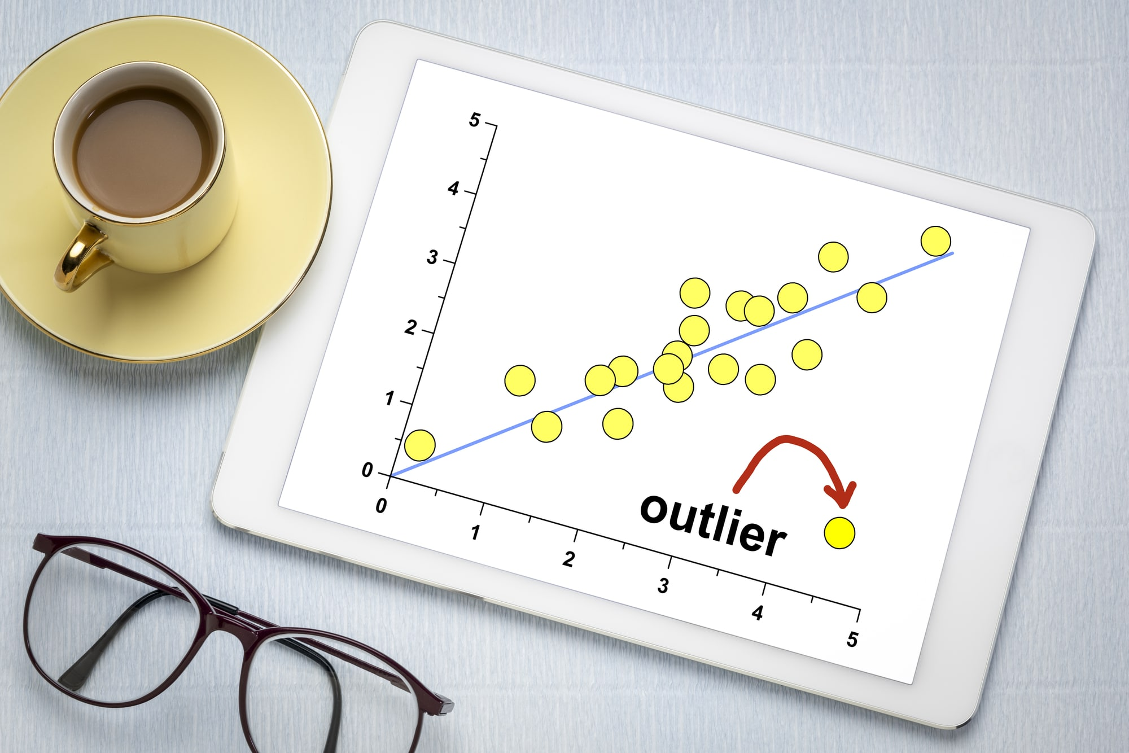

Introduction (Con’t)
Outlier: An outlier is a data point that differs significantly from other observations means
unusual observations
Fig 02: Outlier in a graph
Fig 03: Outlier in real life

Slide 6
Objectives
Modifying existing literature on outlier detection.
Performance comparison with existing words.

Slide 7
Literature Review-01 [1]
IQR / Box plot outlier detection method.
Data set = (22,25,17,19,33,64,23,17,20,18) [N=10]
Arrange the data ascending format = (17,17,18,19,20,22,23,25,33,64)
Q2 = (20+22)/2 = 21 Q1 = 18 Q3 = 25
Inter-Quartile Range (IQR) = Q3-Q1 = 25-18 = 7
Higher outlier = Q3+(1.5*IQR) = 25+(1.5*7) = 35.5
Lower outlier = Q1- +(1.5*IQR) = 18- +(1.5*7) = 7.5
So, Outlier = 64
Minimum value = 17
Maximum value = 33
Q1=18
Q2=21
Q3=25
Minimum=17
Maximum=33
Figure 04: Box Plot

Slide 8
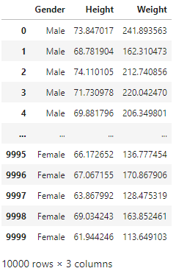
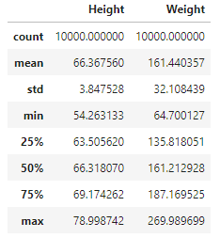
Experimental Analysis of literature review-01
IQR / Box plot outlier detection method.
Table 02: Calculation
Q1(25%)
Q2 (50%)
Q3 (75%)
Minimum
Maximum
Table 01: Dataset
Figure 05: Box Plot

Slide 9
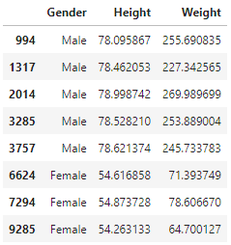
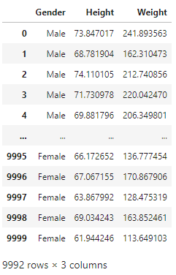
Experimental Analysis of literature review-01Con’t
IQR / Box plot outlier detection method.
Inter-Quartile Range (IQR) = Q3-Q1 = (69.1742617268347 - 63.505620481218955)
= 5.668641245615746
For constant value 1.5:
Lower limit = Q1 - 1.5*IQR
= 55.00265861279534
Upper limit = Q3 + 1.5*IQR
= 77.67722359525831
Table 03: Outliers
Table 04: Dataset without Outlier

Slide 10
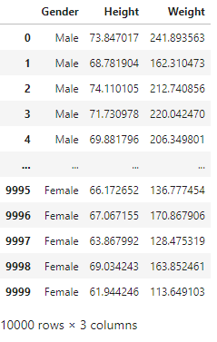

Experimental Analysis of literature review-01Con’t
IQR / Box plot outlier detection method.
For constant value 2:
Lower limit = Q1 - 2*IQR
= 52.168337989987464
Upper limit = Q3 + 2*IQR
= 80.51154421806619
Table 05: No outliers found
Table 06: Dataset without Outlier

Slide 11
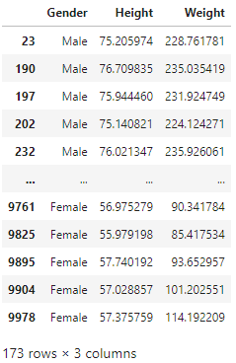
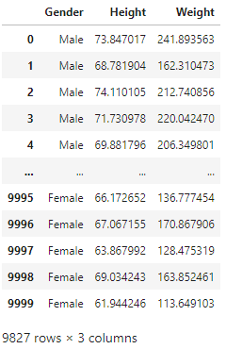
Experimental Analysis of literature review-01Con’t
IQR / Box plot outlier detection method.
For constant value 1:
Lower limit = Q1 - 1*IQR
= 57.83697923560321
Upper limit = Q3 + 1*IQR
= 74.84290297245045
Table 07: Outliers
Table 08: Dataset without Outlier

Slide 12
Experimental Analysis of literature review-01Con’t
IQR / Box plot outlier detection method.
Figure 06: Graphical representation of changing constant values

Slide 13
Experimental Analysis of literature review-01Con’t
IQR / Box plot outlier detection method.
Let’s set the value of Q1 & Q3 as bellow
Inter-Quartile Range (IQR) = Q3-Q1 = (69.81162000527536 - 62.85900650806874)
= 6.95261349720662
Lower limit = Q1 - 1.5*IQR
= 52.43008626225881
Upper limit = Q3 + 1.5*IQR
= 80.24054025108529
Q1(20%)
Q2 (50%)
Q3 (80%)
Minimum
Maximum
Figure 07: Box Plot

Slide 14
Experimental Analysis of literature review-01Con’t
IQR / Box plot outlier detection method.
Q1(20%)
Q2 (50%)
Q3 (80%)
Minimum
Maximum
Figure 08: Box Plot
Table 09: No outliers found
Table 10: Dataset without Outlier

Slide 15
Experimental Analysis of literature review-01Con’t
IQR / Box plot outlier detection method.
Let’s set the value of Q1 & Q3 as bellow
Inter-Quartile Range (IQR) = Q3-Q1 = (71.47214936325072 - 61.41270131336016)
= 10.059448049890563
Lower limit = Q1 - 1.5*IQR
= 46.323529238524316
Upper limit = Q3 + 1.5*IQR
= 86.56132143808657
Q1(10%)
Q2 (50%)
Q3 (90%)
Minimum
Maximum
Figure 09: Box Plot

Slide 16
Experimental Analysis of literature review-01Con’t
IQR / Box plot outlier detection method.
Q1(10%)
Q2 (50%)
Q3 (90%)
Minimum
Maximum
Figure 10: Box Plot
Table 11: No outliers found
Table 12: Dataset without Outlier

Slide 17
Experimental Analysis of literature review-01Con’t
IQR / Box plot outlier detection method.
Let’s set the value of Q1 & Q3 as bellow
Inter-Quartile Range (IQR) = Q3-Q1 = (69.1742617268347 - 63.505620481218955)
= 5.668641245615746
Lower limit = Q1 - 1.5*IQR
= 55.00265861279534
Upper limit = Q3 + 1.5*IQR
= 77.67722359525831
Q1(25%)
Q2 (50%)
Q3 (75%)
Minimum
Maximum
Figure 11: Box Plot

Slide 18
Experimental Analysis of literature review-01Con’t
IQR / Box plot outlier detection method.
Q1(25%)
Q2 (50%)
Q3 (75%)
Minimum
Maximum
Figure 12: Box Plot
Table 13: Outliers
Table 14: Dataset without Outlier

Slide 19
Experimental Analysis of literature review-02Con’t
Figure 13: Graphical representation of result

Slide 20
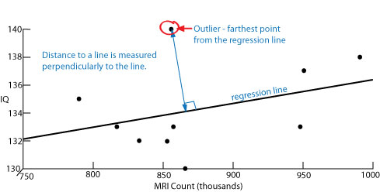
Literature Review-02[2]
Scatter Plots outlier detection method:
If one point of a scatter plot is farther from the regression line than some other point, then the scatter plot has at least one outlier. If a number of points are the same farthest distance from the regression line, then all these points are outliers.
Figure 14: Scatter Plots outlier detection

Slide 21
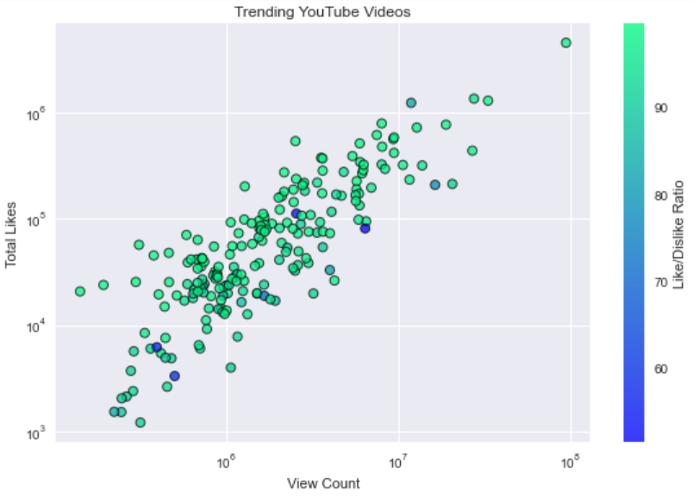
Experimental Analysis of literature review-02Con’t
Scatter Plots outlier detection method:
There is a dataset of trending YouTube videos likes and view ratio. We have almost 200 dataset to implement the model. In this figure the light blue color shows more disliked videos and dark dots are most liked videos.
Figure 15: Scatter Plots outlier detection

Slide 22
Literature Review-03 [3]
Z score outlier detection method:
A z-score is defined as a measure of the divergence of an different experimental observations from the most probable result, the mean. Z is expressed in terms of the number of standard deviations from the mean value.
Z = (X- µ)/ σ …(1)
X = Experimental Value
µ = Mean
σ = Standard Deviation
[Threshold=2]
If Z > threshold that’s outlier.

Slide 23
Experimental Analysis of literature review-03Con’t
Z score outlier detection method:
Dataset = [11, 10, 12, 14, 12, 15, 14, 13, 15, 102, 12, 14, 17, 19, 107, 10, 13, 12, 14, 12, 108, 12, 11, 14, 13, 15, 10, 15, 12, 10, 14, 13, 15, 10, 109, 123]
For threshold = 1 :
Outliers = [102, 107, 108, 109, 123]
For threshold = 2 :
Outliers = [102, 107, 108, 109, 123]

Slide 24
Experimental Analysis of literature review-03Con’t
Z score outlier detection method:
Dataset = [11, 10, 12, 14, 12, 15, 14, 13, 15, 102, 12, 14, 17, 19, 107, 10, 13, 12, 14, 12, 108, 12, 11, 14, 13, 15, 10, 15, 12, 10, 14, 13, 15, 10, 109, 123]
For threshold = 3 :
Outliers = []
For threshold = 0/-1/-2/-3… :
Outliers = [11, 10, 12, 14, 12, 15, 14, 13, 15, 102, 12, 14, 17, 19, 107, 10, 13, 12, 14, 12, 108, 12, 11, 14, 13, 15, 10, 15, 12, 10, 14, 13, 15, 10, 109, 123, 102, 107, 108, 109, 123]

Slide 25
Experimental Analysis of literature review-03Con’t
Figure 16: Graphical representation of changing threshold values

Slide 26
Motivation
Now a days almost every technology uses database based service.
Every dataset has some outliers.
User gather knowledge without outlier is my main motive.

Slide 27
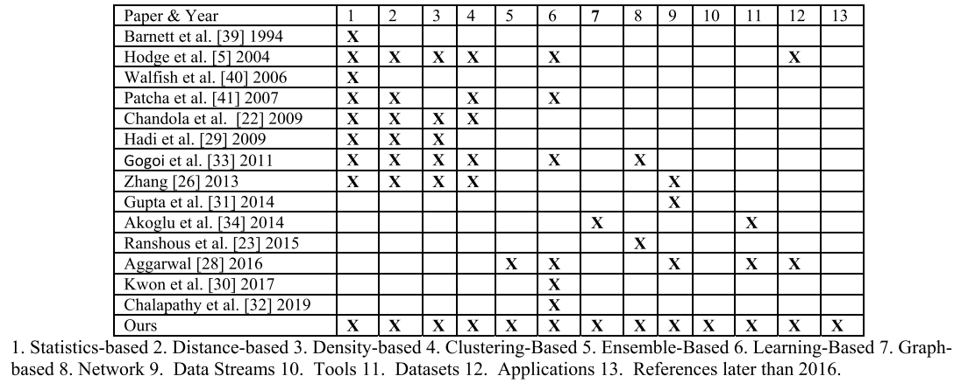
Result Analysis
Table 15: Result analysis

Slide 28
Future Work
Data set implementation in real time
More algorithms analysis to detect outlier.

Slide 29
Conclusion
There is a huge data available in the world. With the needed data there also some unwanted or noisy data. My thesis is to analysis algorithms to detect the outlier or unwanted observations from the dataset and produce only the required data.

Slide 30
References
[1] V. J. Hodge and J. Austin, ‘‘A survey of outlier detection methodologies,’’Artif. Intell. Rev., vol. 22, no. 2, pp. 85–126, 2004.
[2] N. R. Adam, V. P. Janeja, and V. Atluri. Neighborhood-based detection of anomalies in high-dimensional spatio-temporal sensor datasets. In Proceedings of the 2004 ACM symposium on Applied computing, pages 576–583, Nicosia, Cyprus, 2004
[3] Grubbs, F. E, "Procedures for detecting outlying observations in samples", Technometrics 11 (1), February 1969

Slide 31
Thank You

